Slide 1


KIT-KALAIGNARKARUNANIDHI INSTITUTE OF TECHNOLOGY
An Autonomous Institution, Coimbatore – 641402.
Affiliated to Anna University, Chennai
DESIGN OF IoT BASED THERMOMETER ICEAMST-661
Presided By: Under the guidance of:
1. Suriya.S Dr.M.Jayasheela
2. Sanjai Prasath. M Professor,BME.
3. Sachin.R

Slide 2
OBJECTIVE
To design and develop an IoT-based contactless thermometer for real-time body temperature measurement accurately and safely.
It provides real-time monitoring, automatic alerts, and remote data access through IoT technology.
The system is designed to be portable, affordable, and hygienic, making it suitable for use in healthcare and public environments.

Slide 3
INTRODUCTION
Body temperature is a key indicator of human health and vital for early disease detection.
Traditional thermometers require physical contact, posing a risk of cross-contamination.
The COVID-19 pandemic emphasised the need for safe, contactless temperature monitoring.
IoT technology enables real-time data acquisition, wireless communication, and remote health tracking.
The proposed system uses ESP8266 and MLX90614 to design a smart, portable, and accurate contactless thermometer

Slide 4
LITERATURE SURVEY
Reference | Contribution | Key Findings | Research Gaps | Relevance to Current Work
L. M. Pires et al. (2025) | Developed a low-power IoT system for continuous temperature monitoring | Accurate and stable readings | No alert mechanism or portability | Supports IoT-based remote temperature monitoring
M. H. Rahman et al. (2025) | Designed an IoT Thermologger for real-time data tracking | Enables real-time temperature logging and analysis | Lacks portability and cloud alert | Provides base for real-time cloud monitoring
S. P. Ramalingam et al. (2024) | Built a body temperature device using Wi-Fi microcontroller | Wireless temperature display and monitoring | Limited cloud integration | Useful for IoT-based handheld thermometer design
M. Molsom & R. Biswas (2023) | Created contactless auto temperature detector for COVID-19 | Accurate contactless measurement | Fixed installations, no mobility | Inspires IoT integration with alert systems
A. K. Mondal et al. (2021) | Implemented IoT monitoring with ESP8266 and Blynk | Cloud-based temperature visualization | No buzzer alert or data storage | Guides IoT-cloud connection with alert features

Slide 5
MOTIVATION BEHIND THIS PROJECT
The motivation for this project was to make a temperature measurement simpler, faster, and smarter. I wanted to design a device that could work automatically without contact, giving accurate results in real time. The thought of using IoT technology to improve health monitoring and create a portable, low-cost, and user-friendly thermometer inspired me to develop this project.

Slide 6
EXISTING SYSTEM MODEL
The existing temperature measurement systems mainly rely on manual or contact-based thermometers, which require physical contact with the human body. These systems are often slow, less hygienic, and not suitable for continuous or mass screening. Most traditional devices only display readings locally and do not support automation, data storage, or remote monitoring. Even in some existing IoT-based systems, the lack of real-time alerts, portability, and cloud connectivity limits their effectiveness in smart healthcare environments. As a result, the current systems fail to provide a complete and efficient solution for accurate and safe temperature monitoring.

Slide 7
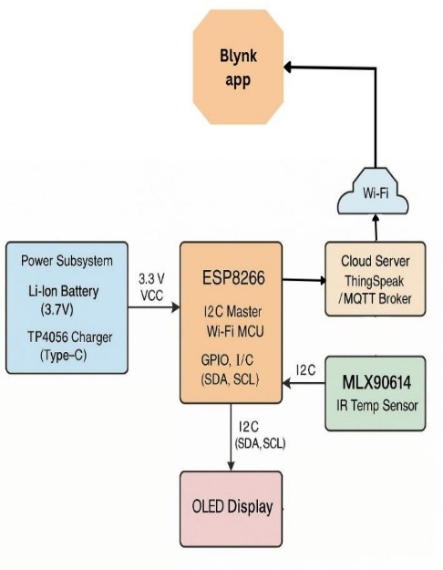
PROPOSED SYSTEM MODEL
1. Power Subsystem (Li-Ion Battery + TP4056 Charger):
Provides a stable 3.3V supply to the entire circuit.
The TP4056 charging module ensures safe charging of the Li-ion battery via a Type-C port, making the system portable and rechargeable.
2.ESP8266 Microcontroller (NodeMCU):
Acts as the main control unit of the system.
The ESP8266 also has built-in Wi-Fi capability, enabling the data to be sent to a cloud platform or mobile app in real-time.
It reads temperature data from the sensor using the I2C communication protocol.
FIGURE 1: BLOCK DIAGRAM OF THE PROPOSED SYSTEM MODEL

Slide 8
PROPOSED SYSTEM MODEL
3. MLX90614 IR Temperature Sensor:
  A contactless infrared sensor that measures the body temperature of the person or object.
  It transmits the measured value to the ESP8266 through the I2C interface for processing and display.
4. OLED Display:
  Displays the instant temperature readings measured by the sensor.
  Provides a clear visual output for easy monitoring.
5. Cloud Server (Blynk):
  Receives the data from the ESP8266 via Wi-Fi and stores it for remote access and data logging.
  Enables continuous monitoring and analysis of temperature data.
6. Blynk App:
  Acts as the user interface on a smartphone.
  Displays real-time temperature readings and alerts the user when the temperature crosses a set threshold.

Slide 9
PROPOSED SYSTEM MODEL
PSEUDOCODE OF THE PROPOSED SYSTEM
Step 1: Initialise serial communication, MLX90614 sensor, OLED display, Wi-Fi module, and connect to the Blynk cloud.
Step 2: Continuously read temperature values from the MLX90614 sensor through the I²C interface.
Step 3: Display the current temperature on the OLED screen in Celsius.
Step 4: If temperature > threshold (i.e 38°C), activate buzzer; else, keep the buzzer OFF.
Step 5: Send temperature and alert data to the Blynk cloud using virtual pins and repeat the process continuously.

Slide 10
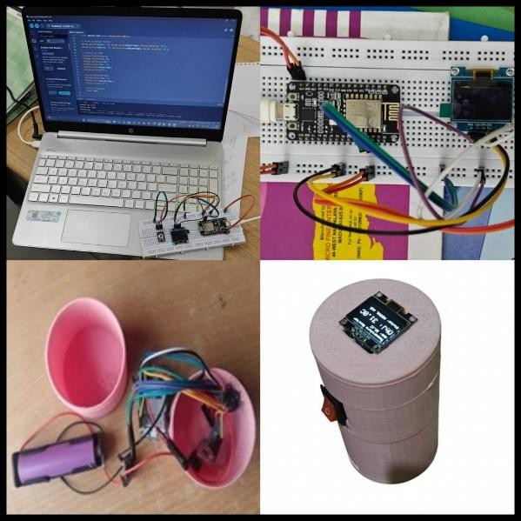
RESULTS AND DISCUSSIONS
Hardware Implementation:
Figure 2 shows the hardware implementation of the proposed system. For precise temperature monitoring, the concept combines a non-contact thermal sensor with a microprocessor that can connect to Wi-Fi. The user may see the measured data instantaneously on a small OLED display. A buzzer is included when readings are deemed abnormal. The entire gadget is powered by a 3.7V rechargeable battery, ensuring portability and continuous operation. Every part is safely housed in a portable 3D-printed model, demonstrating functionality and practical application for both personal and medical uses.
FIGURE 2: HARDWARE IMPLEMENTATION
OF THE PROPOSED SYSTEM

Slide 11
RESULTS AND DISCUSSIONS
TABLE: COMPARISON OF THE PROPOSED SYSTEM AND THE CONVENTIONAL SYSTEM WITH THRESHOLD STATUS
The table shows the comparison of the proposed system and the conventional system with threshold status. From the table, it can be seen that with only a ±0.1°C difference, the comparison demonstrates how well the suggested approach matches the traditional system. Hence, The Proposed contactless temperature monitoring system for real-time patient evaluation has a high degree of accuracy and reliability.
Patient ID | Proposed System (°C) | Conventional System (°C) | Threshold Status
P001 | 35.6 | 35.8 | Normal
P002 | 36.2 | 36.4 | Normal
P003 | 36.8 | 37.0 | Normal
P004 | 37.1 | 37.2 | Slightly Elevated
P005 | 37.5 | 37.6 | Mild Fever
P006 | 38.0 | 38.1 | Moderate Fever
P007 | 38.4 | 38.3 | High Fever
P008 | 39.0 | 39.1 | High Fever
P009 | 39.5 | 39.6 | Very High Fever
P010 | 40.0 | 39.9 | Critical Temperature

Slide 12
CONCLUSION
The proposed system provides accurate and contactless body temperature monitoring using IoT.
MLX90614 sensor and ESP8266 module ensure fast data transfer and reliable performance.
Temperature values are shown on an OLED display and sent to the Blynk cloud for remote access.
The device is portable, low-cost, and hygienic, suitable for public and healthcare use.
Overall, it achieves a smart, safe, and efficient solution for real-time temperature screening.

Slide 13
REFERENCES
[1] L. M. Pires, J. Figueiredo, R. Martins, J. Nascimento, and J. Martins, “Design and Development of a Low-Power IoT System for Continuous Temperature Monitoring,” Designs, vol. 9, no. 3, p. 73, 2025.
[2] M. H. Rahman, M. M. Reza, R. Ferdous, Naderuzzaman, and M. A. Kashem, “Development of an IoT-Based Thermologger for Real-Time Temperature Monitoring,” Internet of Things and Cloud Computing, vol. 13, no. 2, pp. 28–37, 2025.
[3] J. Nabão, “IoT-Based Real-Time Temperature Monitoring in Critical Environments,” IGMin Research Journal of Engineering and Technology, 2025.
[4] “Smart Health Monitoring System Based on Internet of Things,” Journal of Neonatal Surgery, 2025.
[5] “A Portable IoT-Based Health Monitoring Framework Using ESP32 for Isolated and Home-Based Patient Care,” ResearchGate Preprint, 2025.

Slide 14
Thank You!
Any Questions?

